Slide 1
Top Data Science Skills by Job Postings
Bridget Boakye, Wilson Ng, Neil Hodgkinson, Marjete Vucinaj

Slide 2

Approach
Problem statement: what are the most valued skills in data science?
We use labor demand as proxy for value of skills
Indeed, for many people, a skill’s value is measured by its demand in the job market which inevitably means how fast and for what salary they can get a job

Slide 3
Data Source: Kaggle, Jeff Hale, 2018

Slide 4
Step 1: Data Cleaning & Analysis
Pulled data in and creating data frames (skills = SKDF, software = SFDF)
Ensure all data types were correct. (Chr, num, etc)
Removed Columns & rows
Created a “total” column
Exported data frames out as .csv

Slide 5
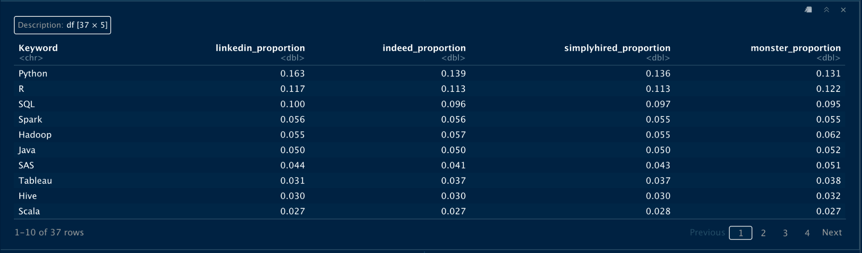
Step 2a: Data Analysis, Software

Slide 6
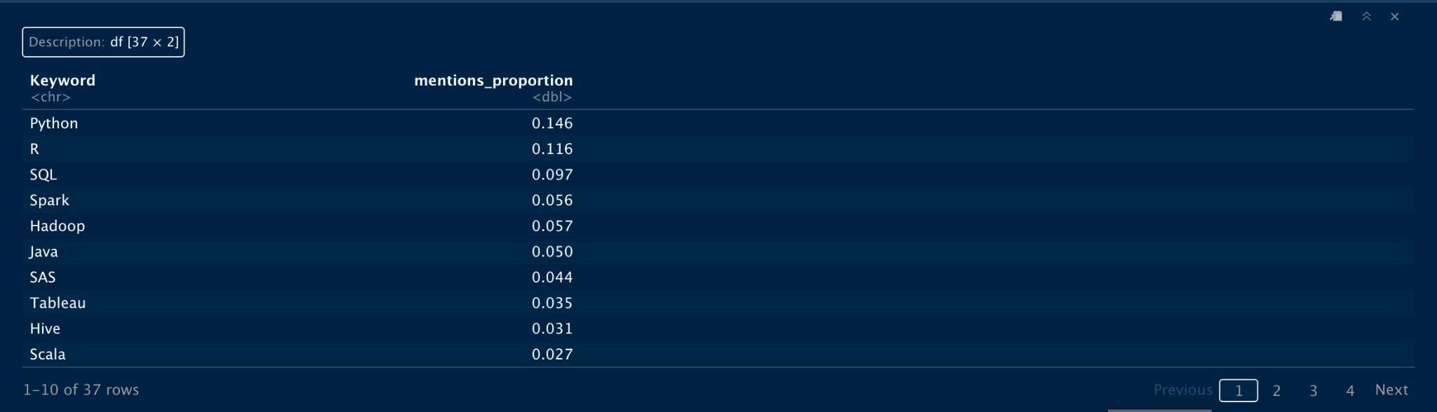
Step 2a: Data Analysis, Software

Slide 7
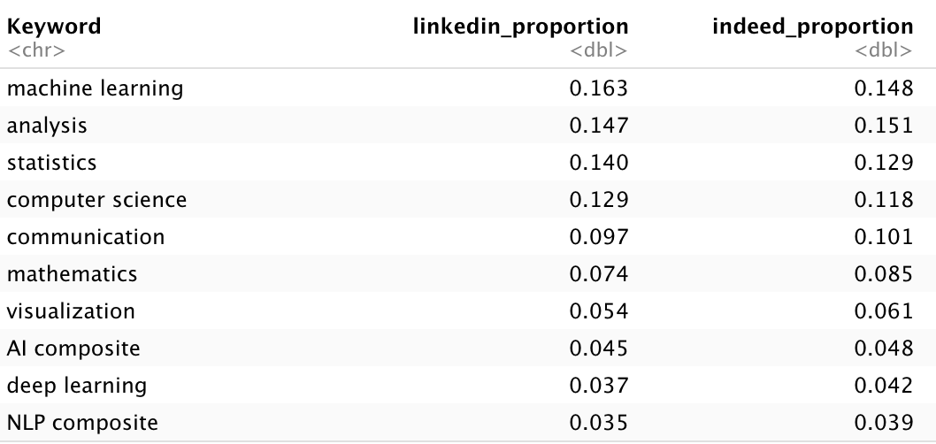
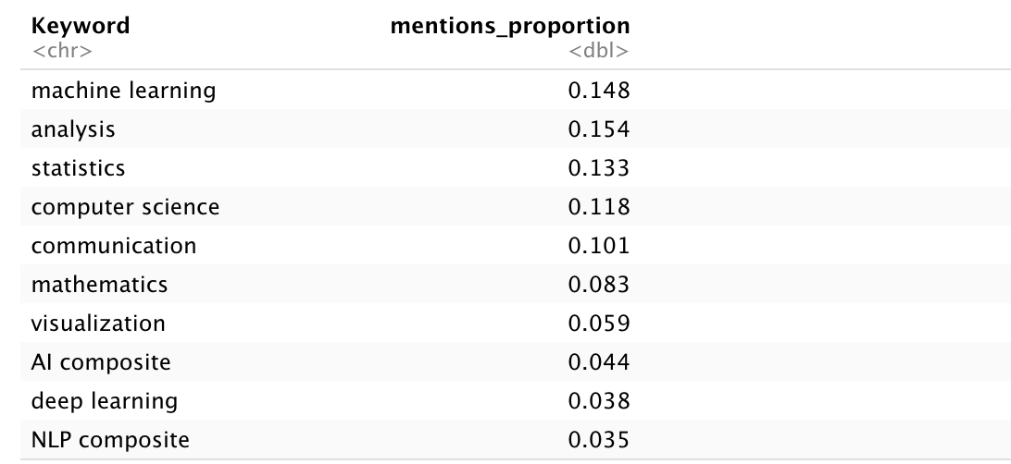
Step 2b: Data Analysis, Skills
Find proportion of each skill for each website
2. Find proportion of skills across all websites

Slide 8
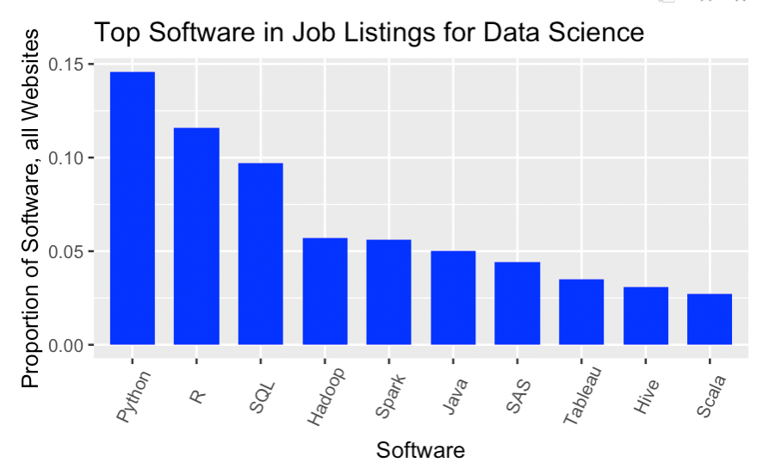
Step 3a: Visualisations, Software Across All Websites

Slide 9
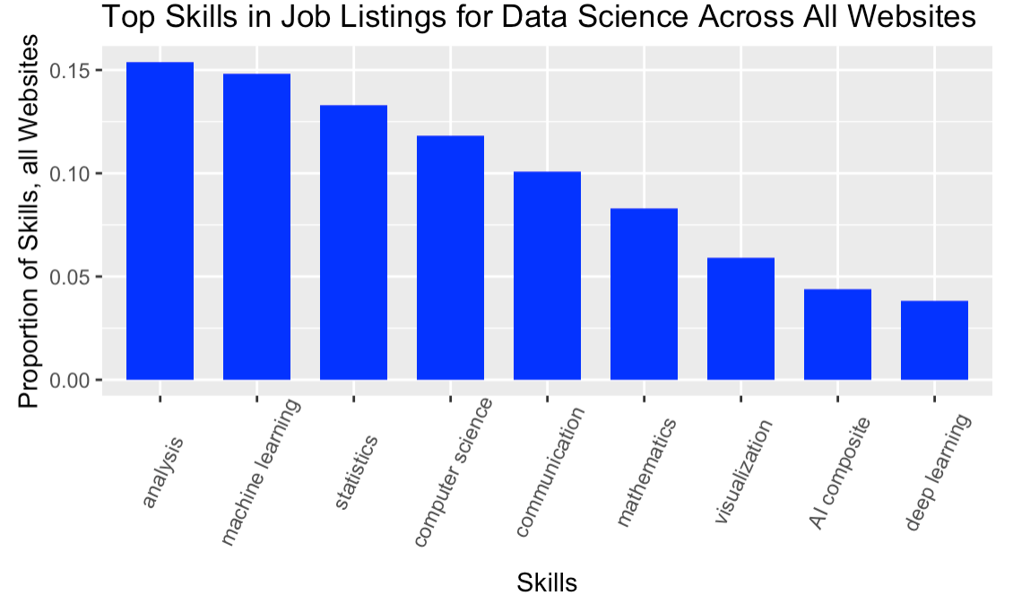
Step 3b: Visualisations, Skills Across Websites

Slide 10
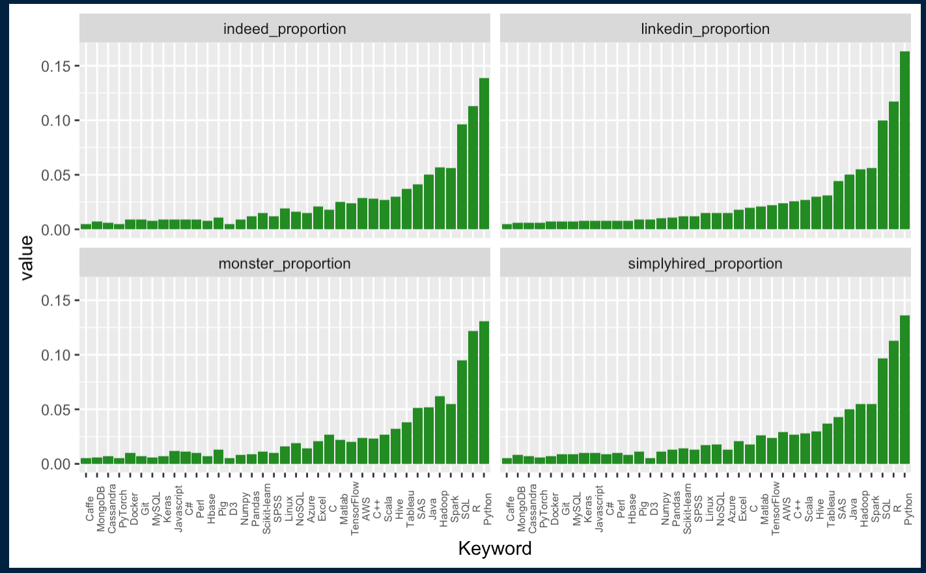
Step 3c: Visualisations, Software For Each Website

Slide 11
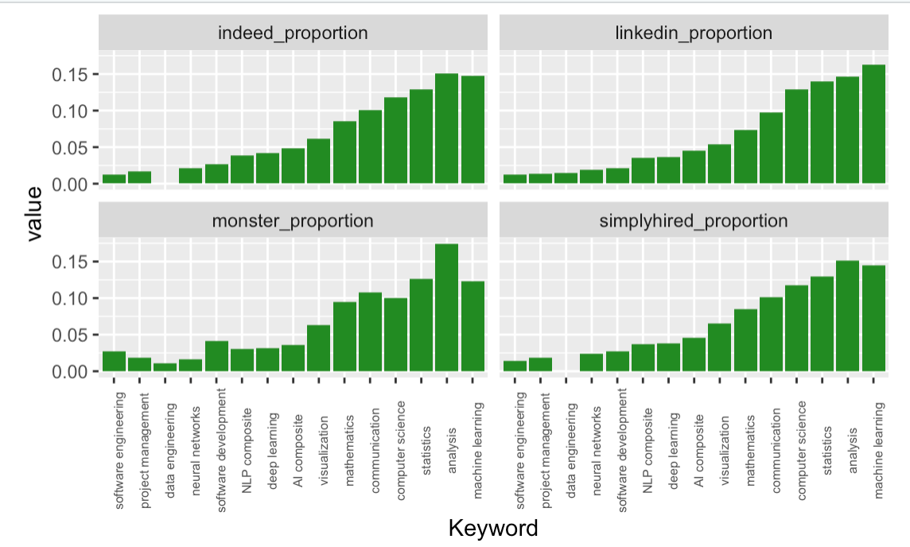
Step 3d: Visualisations, Skills For Each Website

Slide 12
Take-Aways:
According to employer demand, the most valued skills in data science are: Python and Analysis

Slide 13
However, there are some differences across sites, specifically for skills, that job seekers should pay attention to maximise their position in the job market.

Slide 14

Future Work
Update dataset for comparison - Jeff’s dataset is from 2018
Map skills to salary to further assess value in market
Look at requirements for promotion within the field of Data Science
Investigate other websites geared towards tech roles, such as angel.co and built.in

